Slide 1

Ben Gruher
Priyanka Patil
Sreebindu Rachapudi

Slide 2
Problem Overview
Application for searching global addresses
Addresses should be in country-specific format
Web-based UI and API for querying system
Emphasis on performance and concurrency

Slide 3
Design Decisions

Slide 4
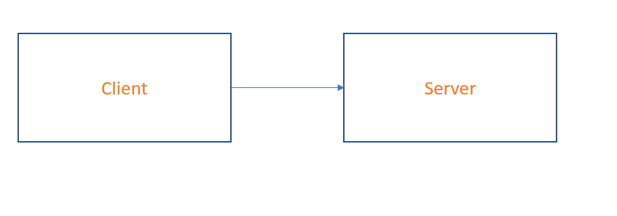
Design Choices - Client-Server

Slide 5
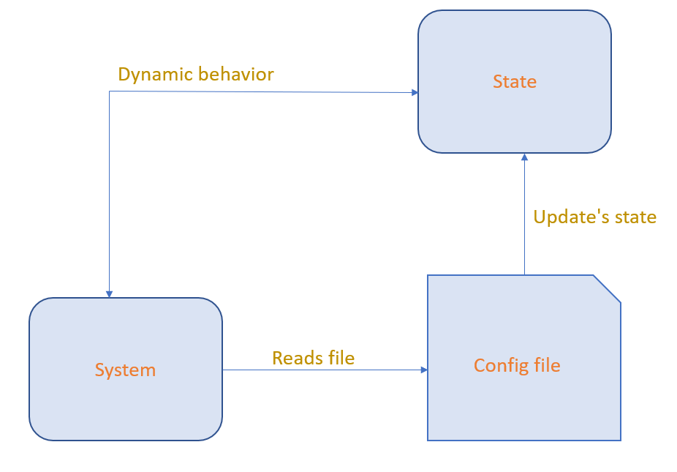
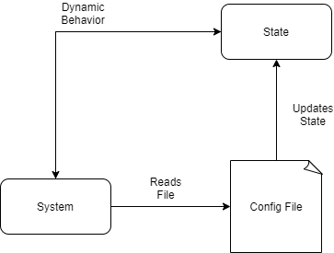
Design Choices - Data-Driven
Notes:
System needs to conform to data, not other way around.
Data is subject to change.
Data = system behavior
Have data somewhere, but not in code (so that application wouldn’t have to be recompiled everytime the data changed)

Slide 6
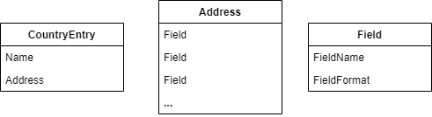
Object Diagram

Slide 7
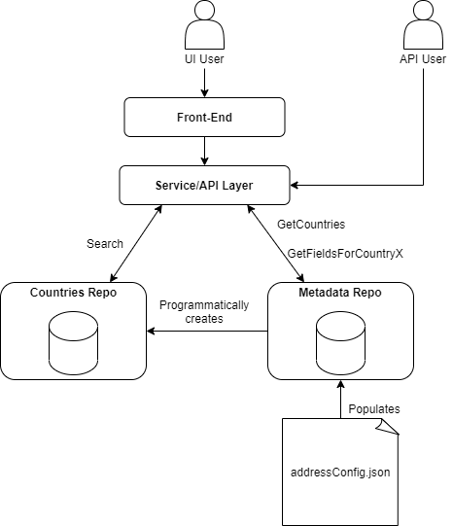
Architecture Overview
Notes:
Countries repo doesn’t exist before system is run - countries repo created on the fly based on the data in the config file.

Slide 8
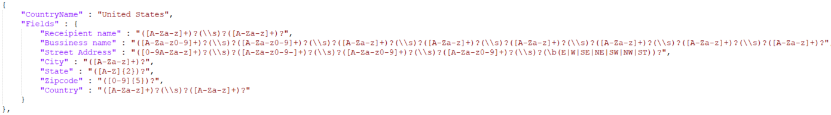
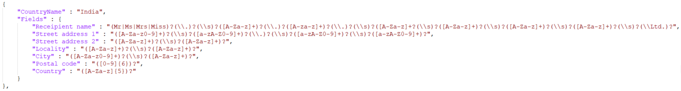
Dynamic Configuration
Notes:
Config file is where all the information is stored. No values in the system were coded, everything was read from this config file.

Slide 9
Architecture Overview

Slide 10
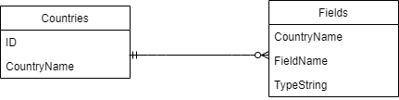
Metadata Repository

Slide 11
Metadata Storage
CountryFields
CountryName | FieldName | TypeString
Canada | Province | ([A-Za-z0-9]{2})
Canada | Street | ([0-9]+)?(\\-)?([0-9]+)?(\\s)?([0-9])?(\/)?([0-9])?(\\s)?([A-Za-z]+)?(\\s)?([A-Za-z]+)?(\\s)?(\b(Ave|W|Rd|E|STREET|NW|SW|SE|NE))?
Canada | City | ([A-za-z]+)?(\\s)?([A-za-z]+)?
USA | Name | ([A-Za-z]+)?(\\s)?([A-Za-z]+)
USA | Zip | ([0-9]{5})?
USA | City | ([A-Za-z]+)?
Countries
CountryID | CountryName
1 | Canada
2 | USA
3 | Belgium

Slide 12
Architecture Overview

Slide 13
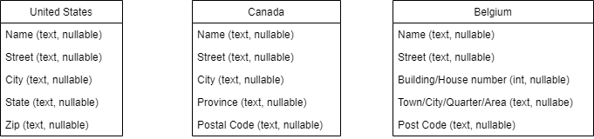
Countries Repository

Slide 14
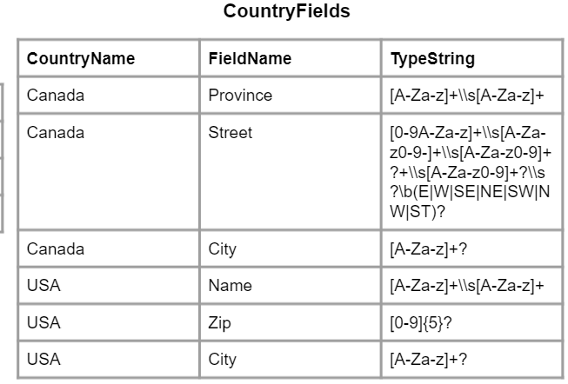
Creating Dynamic Address Formats
(from metadata)
CanadaAddresses
Street | City | Province
3095 Woolwick Drive | Toronto | Ontario
755 Avenue Royale | Quebec | Quebec
Notes:
Simplified example!

Slide 15
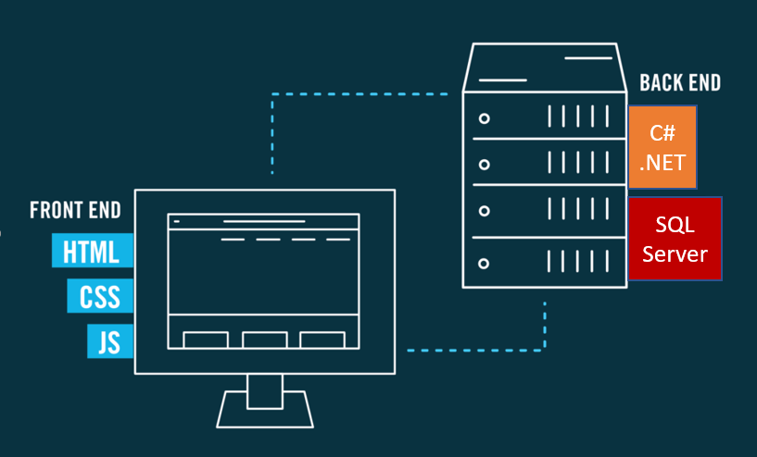
Technologies Stack:

Slide 16



Database Choice

Slide 17
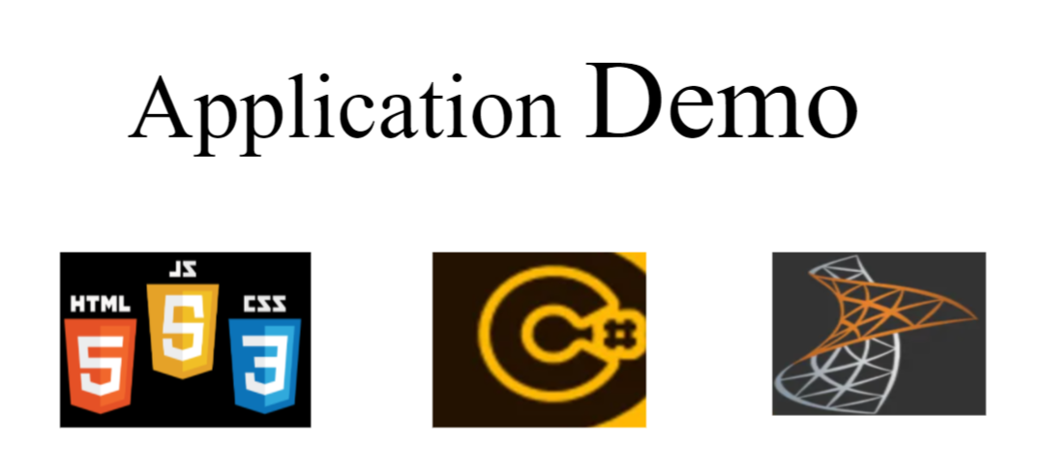

Slide 18
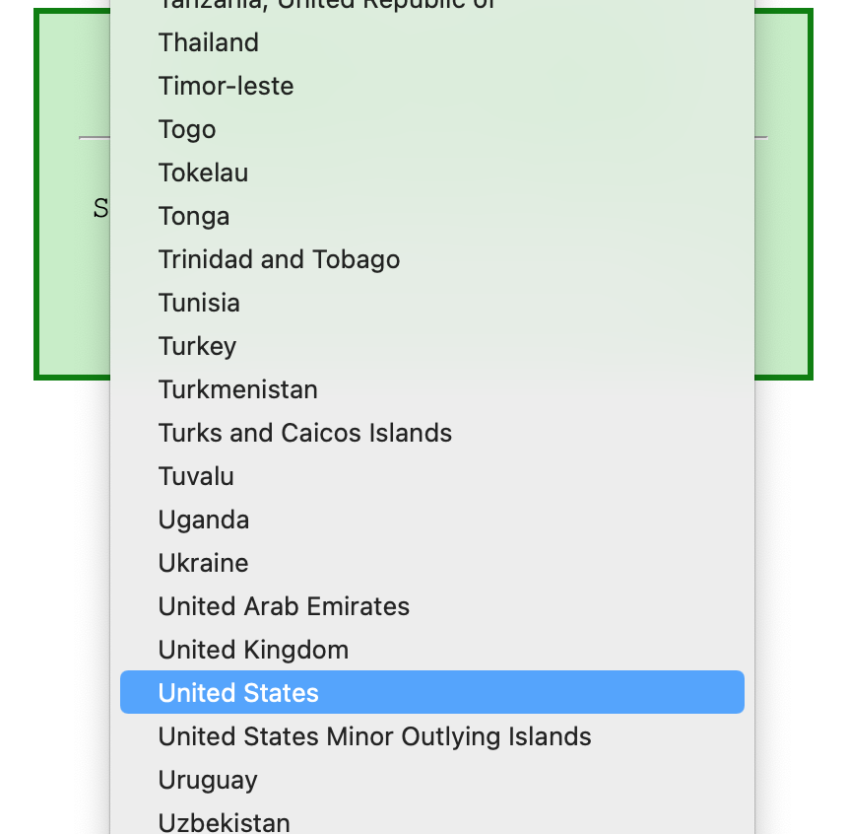
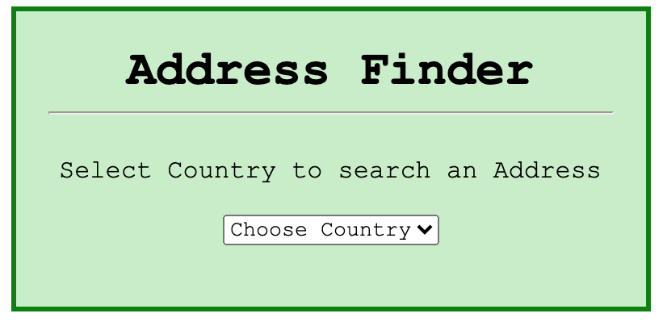
http://AddressFinderDemo/index.html

Slide 19
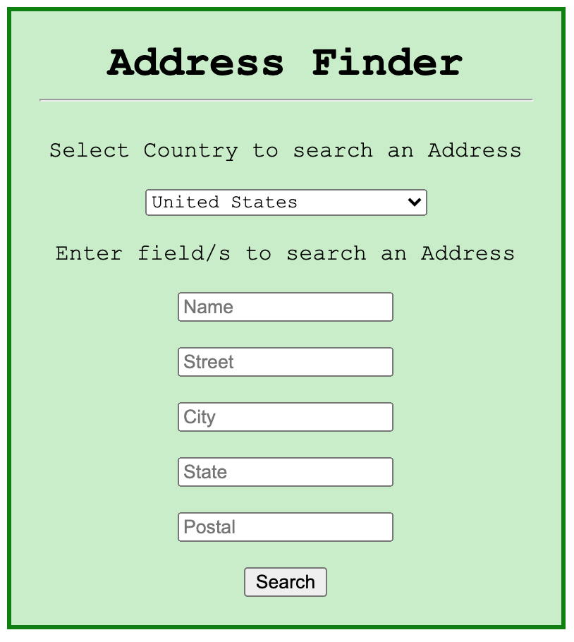
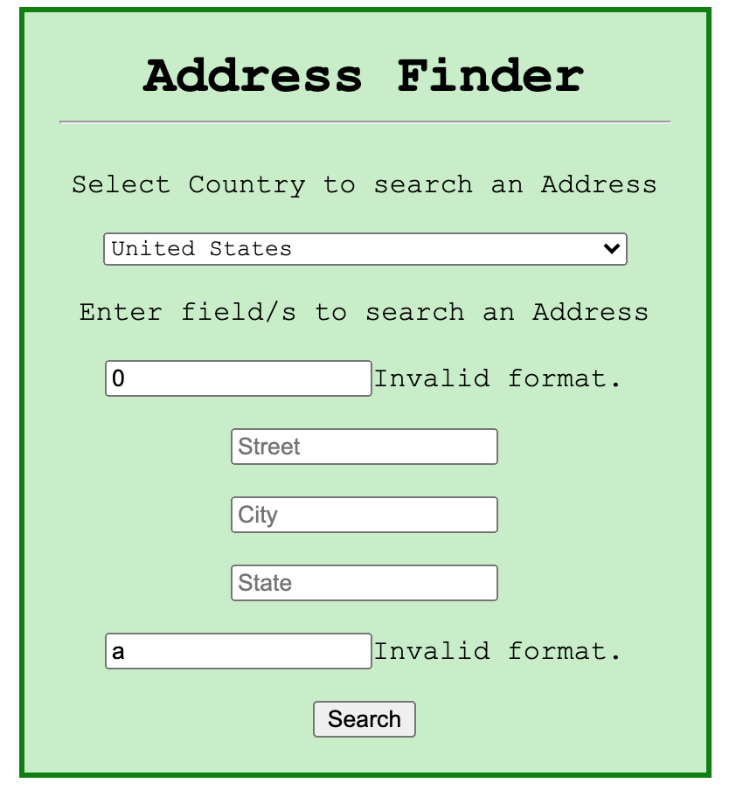

Slide 20
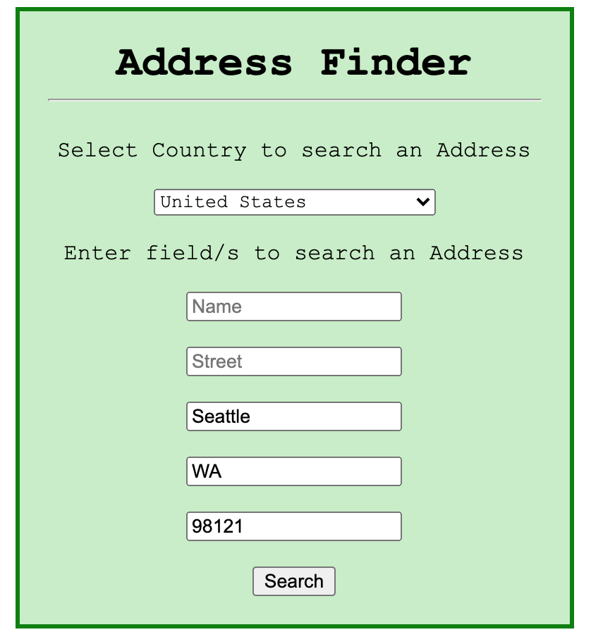
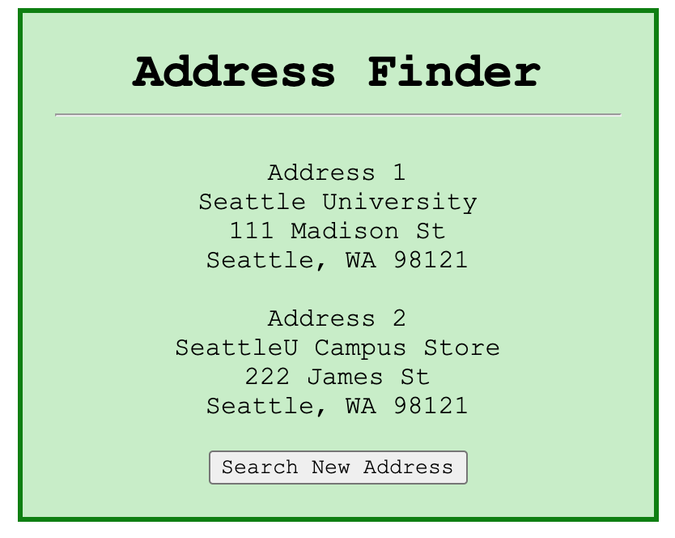

Slide 21
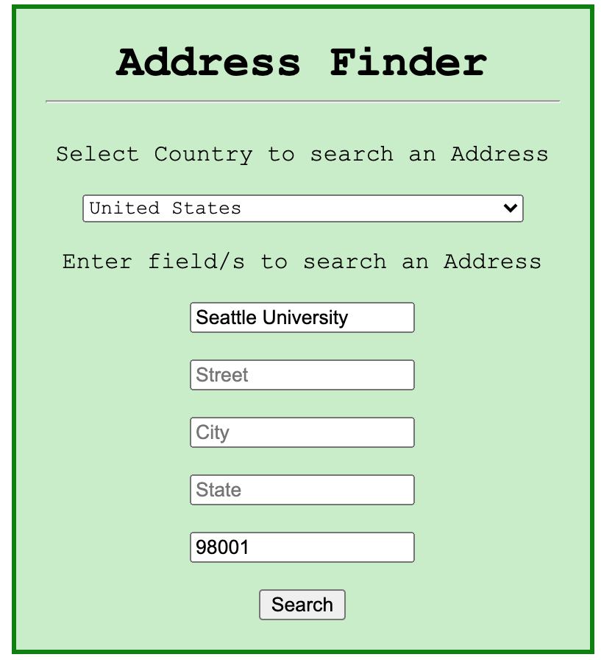
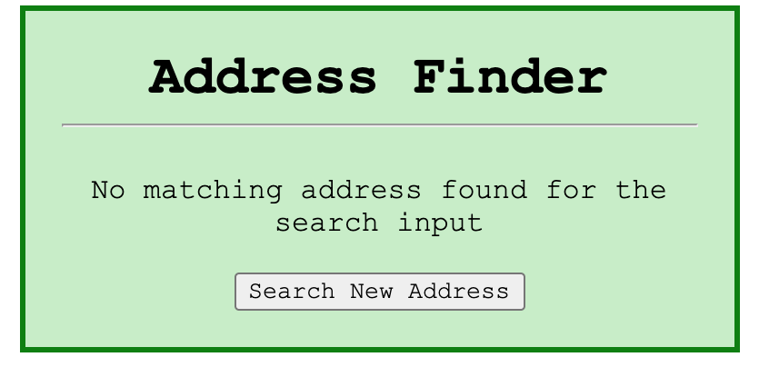

Slide 22
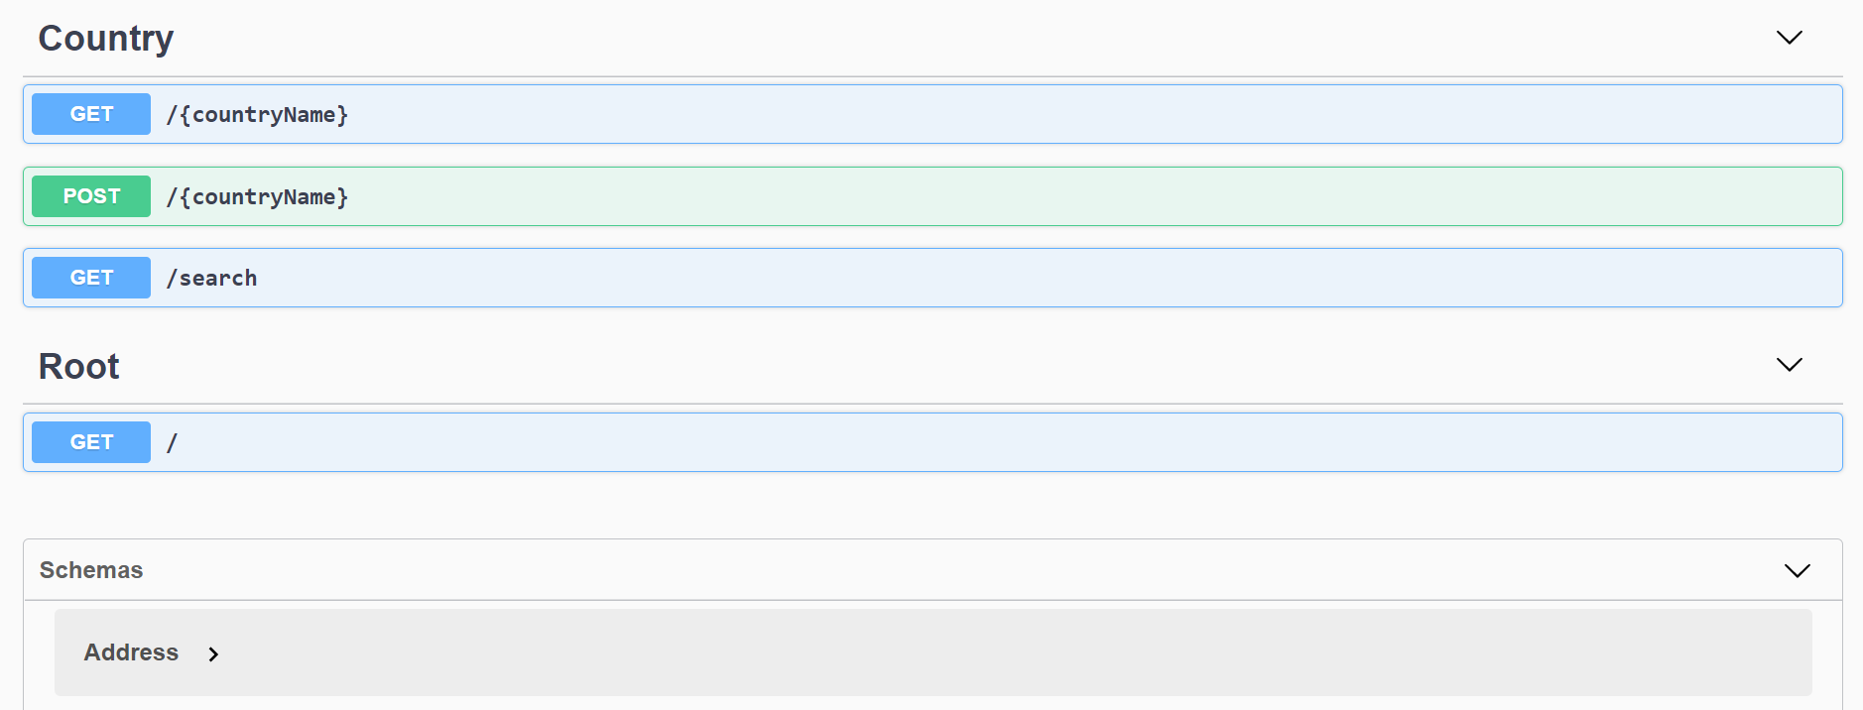
API Interface

